Slide 1
State Machines

Slide 2
State Machines
A state machine – a mathematical model of computation
Essentially it is a way of describing a way something works in a series of states, actions, and outputs
Think of it as an organizational method:
You can break down a mechanism into logical statements that execute when in a certain state, then determine which state to go to next.

Slide 3
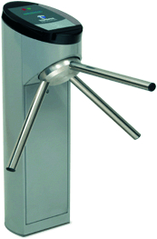
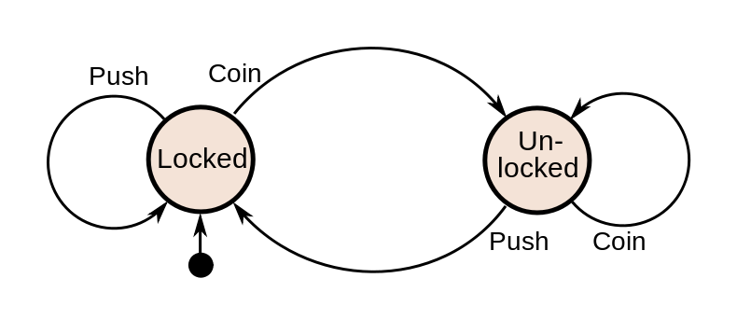
State Machines
Example: Coin Turnstile

Slide 4
State Machines
Why? – Commonly used in engineering to break down a complex problem into a more manageable systems of states and state transitions
Building a state machine – break your project into a series of “things to do” and under what circumstances you need to do them.
Organization – 1) Things to do 2) when to change 3) Where to go

Slide 5
State Machines
Let’s build a state machine to do a simple task: Parsing through a string to find another three character string!
W | o | r
H | e | l | l | o |  | W | o | r | l | d | \0

Slide 6
State Machines
First, we need to find the first character
W | o | r
H | e | l | l | o |  | W | o | r | l | d | \0

Slide 7
State Machines
First, we need to find the first character
W | o | r
H | e | l | l | o |  | W | o | r | l | d | \0

Slide 8
State Machines
First, we need to find the first character
W | o | r
H | e | l | l | o |  | W | o | r | l | d | \0

Slide 9
State Machines
First, we need to find the first character
W | o | r
H | e | l | l | o |  | W | o | r | l | d | \0

Slide 10
State Machines
First, we need to find the first character
W | o | r
H | e | l | l | o |  | W | o | r | l | d | \0

Slide 11
State Machines
First, we need to find the first character
W | o | r
H | e | l | l | o |  | W | o | r | l | d | \0

Slide 12
State Machines
First, we need to find the first character
W | o | r
H | e | l | l | o |  | W | o | r | l | d | \0

Slide 13
State Machines
First, we need to find the first character
W | o | r
✓
H | e | l | l | o |  | W | o | r | l | d | \0

Slide 14
State Machines
Second, we need to find the second character
W | o | r
H | e | l | l | o |  | W | o | r | l | d | \0

Slide 15
State Machines
Second, we need to find the second character
W | o | r
✓
H | e | l | l | o |  | W | o | r | l | d | \0

Slide 16
State Machines
Lastly, we need to find the third character
W | o | r
H | e | l | l | o |  | W | o | r | l | d | \0

Slide 17
State Machines
Lastly, we need to find the third character
W | o | r
✓
H | e | l | l | o |  | W | o | r | l | d | \0

Slide 18
State Machines
✓
DONE
W | o | r
H | e | l | l | o |  | W | o | r | l | d | \0

Slide 19
State Machines
So, we essentially broke it down into 3 states
If you are looking for the first character
If you are looking for the second character
If you are looking for the third character
State 1
Looking for First Char
State 2
Looking for Second Char
State 3
Looking for Third Char

Slide 20
State Machines
Now we need to determine when it is okay to move to the next state
State 1
Move to State 2 when you see the first character
Otherwise stay in state 1.
State 2
Looking for Second Char
State 1
Looking for First Char
State 3
Looking for Third Char

Slide 21
State Machines
Now we need to determine when it is okay to move to the next state
State 2
Move to State 1 if the next character is not the second search character
Go to State 3 if it is
If the character is the first search character stay
State 1
Looking for First Char
State 2
Looking for Second Char
State 3
Looking for Third Char

Slide 22
State Machines
Now we need to determine when it is okay to move to the next state
State 3
Complete the machine if the character is the third search character
Go back to state one otherwise
✓
State 1
Looking for First Char
State 2
Looking for Second Char
State 3
Looking for Third Char

Slide 23
State Machines
Let’s put our machine to the test!
State 1
W | o | r
W | W | o | W | r | W | W | o | r | l | d | \0

Slide 24
State Machines
Let’s put our machine to the test!
State 1
W | o | r
✓ Move to state 2
W | W | o | W | r | W | W | o | r | l | d | \0

Slide 25
State Machines
Let’s put our machine to the test!
State 2
W | o | r
W | W | o | W | r | W | W | o | r | l | d | \0

Slide 26
State Machines
Let’s put our machine to the test!
State 2
W | o | r
✗ Stay in State 2
W | W | o | W | r | W | W | o | r | l | d | \0

Slide 27
State Machines
Let’s put our machine to the test!
State 2
W | o | r
W | W | o | W | r | W | W | o | r | l | d | \0

Slide 28
State Machines
Let’s put our machine to the test!
State 2
W | o | r
✓ Move to state 3
W | W | o | W | r | W | W | o | r | l | d | \0

Slide 29
State Machines
Let’s put our machine to the test!
State 3
W | o | r
W | W | o | W | r | W | W | o | r | l | d | \0

Slide 30
State Machines
Let’s put our machine to the test!
State 3
W | o | r
✗ Move to State 1
W | W | o | W | r | W | W | o | r | l | d | \0

Slide 31
State Machines
Let’s put our machine to the test!
State 1
W | o | r
W | W | o | W | r | W | W | o | r | l | d | \0

Slide 32
State Machines
Let’s put our machine to the test!
State 1
W | o | r
✗ Stay in State 1
W | W | o | W | r | W | W | o | r | l | d | \0

Slide 33
State Machines
Let’s put our machine to the test!
State 1
W | o | r
W | W | o | W | r | W | W | o | r | l | d | \0

Slide 34
State Machines
Let’s put our machine to the test!
State 1
W | o | r
✓ Move to state 2
W | W | o | W | r | W | W | o | r | l | d | \0

Slide 35
State Machines
Let’s put our machine to the test!
State 2
W | o | r
W | W | o | W | r | W | W | o | r | l | d | \0

Slide 36
State Machines
Let’s put our machine to the test!
State 2
W | o | r
✗ Stay in State 2
W | W | o | W | r | W | W | o | r | l | d | \0

Slide 37
State Machines
Let’s put our machine to the test!
State 2
W | o | r
W | W | o | W | r | W | W | o | r | l | d | \0

Slide 38
State Machines
Let’s put our machine to the test!
State 2
W | o | r
✓ Move to state 3
W | W | o | W | r | W | W | o | r | l | d | \0

Slide 39
State Machines
Let’s put our machine to the test!
State 3
W | o | r
W | W | o | W | r | W | W | o | r | l | d | \0

Slide 40
State Machines
Let’s put our machine to the test!
State 3
W | o | r
✓ DONE
W | W | o | W | r | W | W | o | r | l | d | \0

Slide 41
State Machines
Let’s put our machine to the test!
State 3
W | o | r
W | W | o | W | r | W | W | o | r | l | d | \0

Slide 42
State Machines
How to code them
Use the switch statements to your advantage
int state1 = 1;
int state2 = 2;
int state3 = 3;
int curr = state1;
switch(curr)
{
case state1:
//Stuff
break;
case state2:
//Stuff
break;
case state3;
//Stuff
break;
}

Slide 43
State Machines
How to code them (Alternative)
Use the switch statements to your advantage
enum state{
state1,
state2,
state3
};
state curr = state1;
switch(curr)
{
case state1:
//Stuff
break;
case state2:
//Stuff
break;
case state3;
//Stuff
break;
}

